Slide 1
Smart Water Level And Quality Monitoring via Smart IoT Framework
Under The Guidance of:-
Dr. Vinay Chamola
Assistant Professor
Department of Electrical and Electronics Engineering
Team Members:
Divyesh Narayanan 2018A8PS0453P
Aayush Agarwal 2018A8PS0425P
Ansh S. Shah 2018B5PS0917P
Neelaksh Singh 2018A3PS0337P
Divyansh Agarwal 2018A3PS0791P

Slide 2
Inspiration for the Project
Water is a precious resource which must be used with care.
In vast systems, supervision of the water levels and tank maintenance is difficult.
The project can be implemented in the BITS Pilani campus, especially considering the water supply in Pilani, conserving water and taking a further stride in making our campus into a “Smart Campus”.

Slide 3
Objective of the Project
OBJECTIVE-
Monitoring and maintaining sufficient water level in the tanks
Limiting water wastage
Maintaining the water quality in the tanks
Making the supervision of the entire process easy

Slide 4
Our Solution
Water level monitoring
Automation of the Water Pump Motors
Water Quality Monitoring
Evaluation of Water Consumption Demand – Machine Learning helping to understand the times there are peaks and troughs in the water consumption and accordingly ensuring the water level in the tank will be sufficient
Easy Interface – An mobile app for the concerned authority to access the real-time data on the go with override control on the motors in case of emergency.

Slide 5
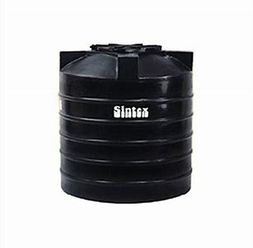
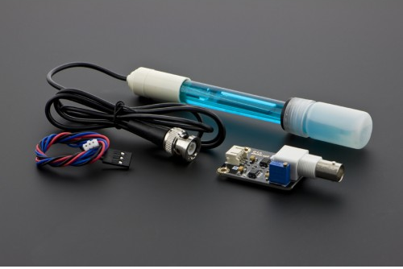
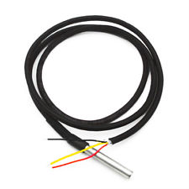
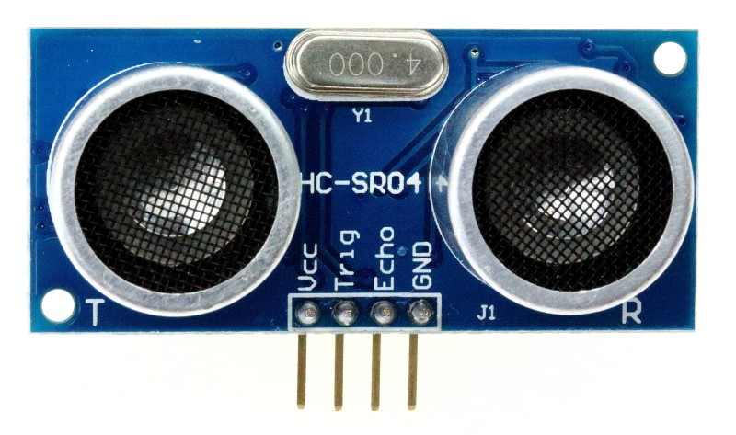

Implementation
Turbidity
Waterproof HC-SR04 Ultrasound module
Analog pH sensor with Electrode
DS18B20 Digital Temperature
Oxidation reduction potential (ORP)
Electrical conductivity
Dissolved Oxygen Sensor

Slide 6

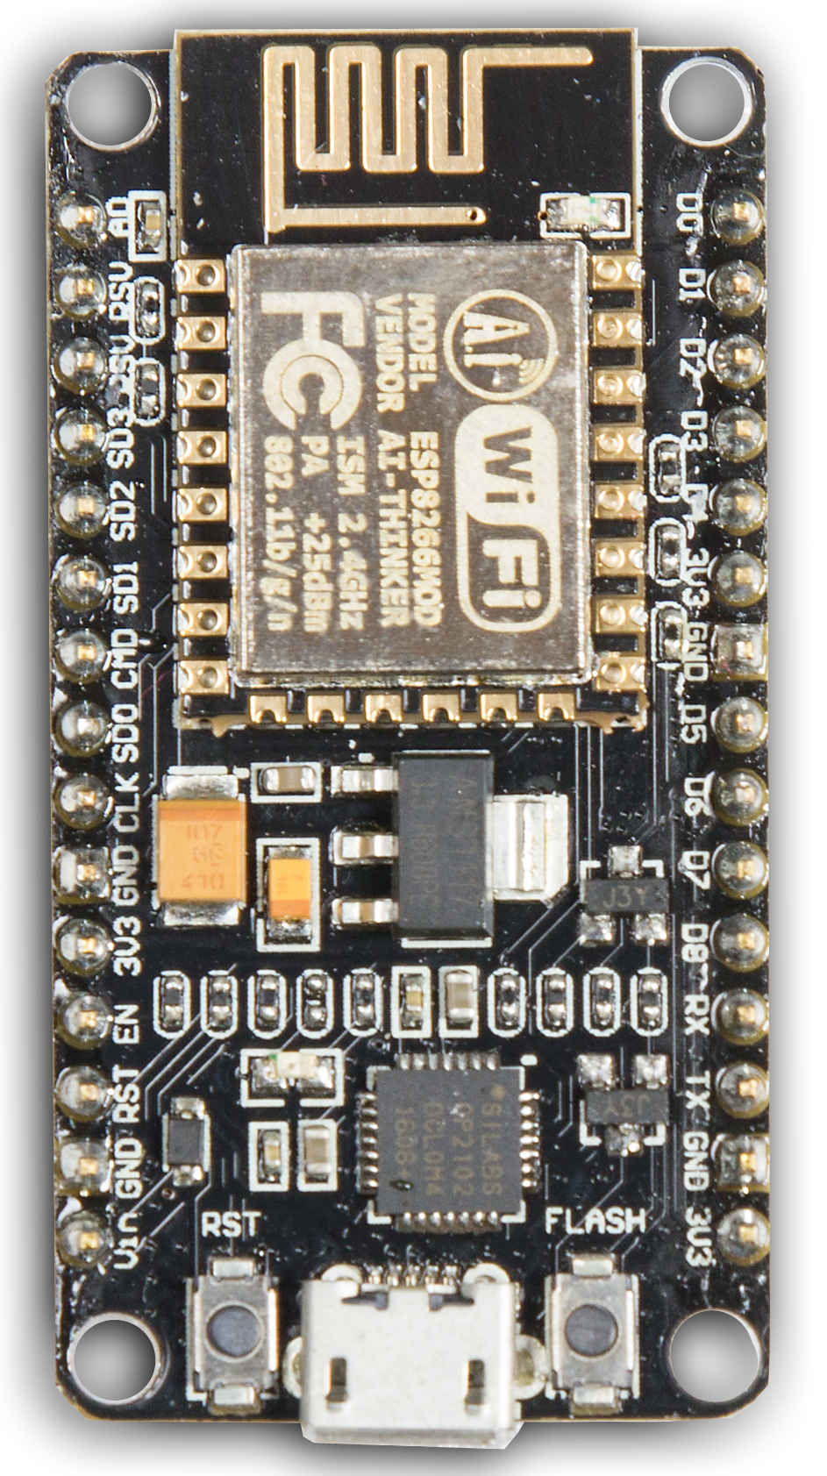
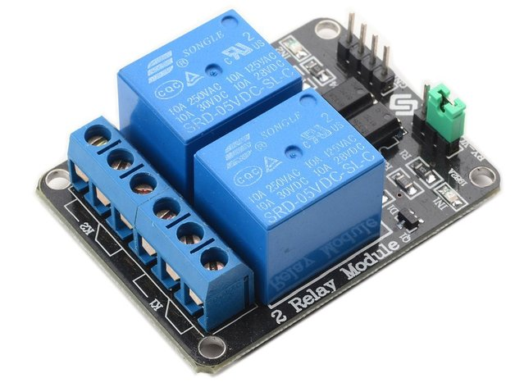
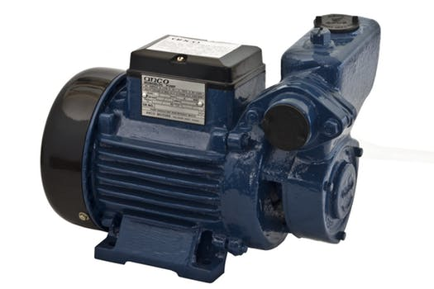
Server
(Thingspeak)

Slide 7
Materials Required
Item | Cost per piece | Quantity | Net Cost
ESPE266 Node MCU | 340 | 4 | 1360
DS18B20 Digital Temperature Sensor | 150 | 1 | 150
pH electrode probe bnc + pH0-14 ph detection module | 1000 | 1 | 1000
HC-SR04 | 100 | 3 | 300
Waterproof Transceiver for HC-SR04 (Zhipo) (Set of 10) | 1100 | 1 | 1100

